Slide 1
24 Frames Per Second: Preserving and Digitizing At-Risk Amateur Films
Tasha Caswell Research & Collections Associate Connecticut Historical Society
tasha_caswell@chs.org
860-236-5621 x221

Slide 2
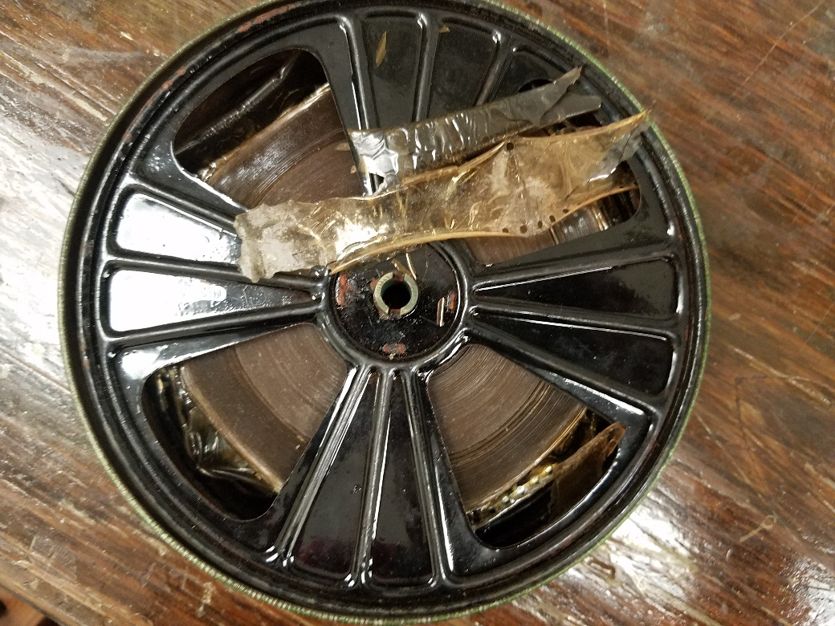
The problem(s)
Vinegar syndrome in the motion picture collection

Slide 3
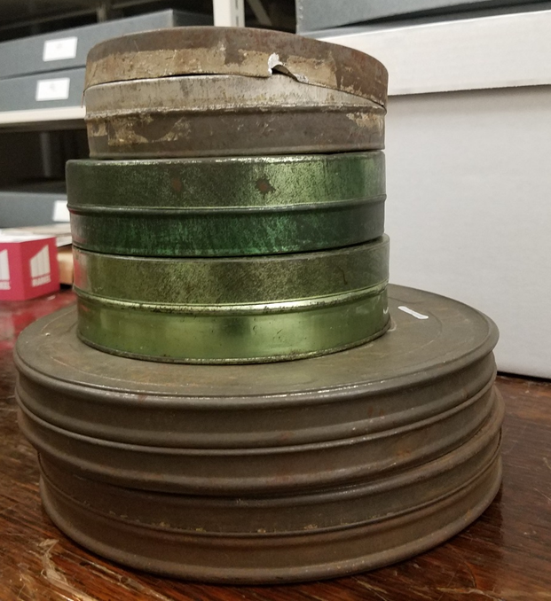
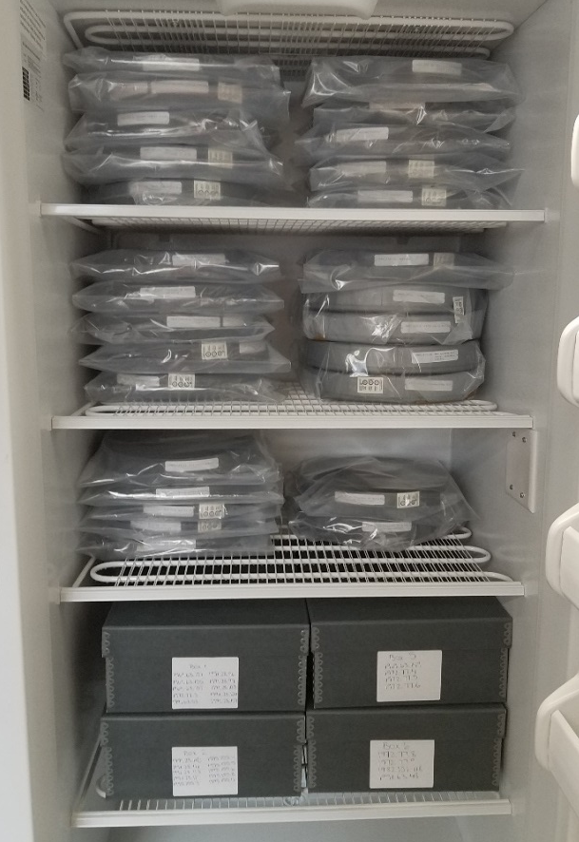
the solution(s)
Physical preservation of originals
From this…
To this!

Slide 4
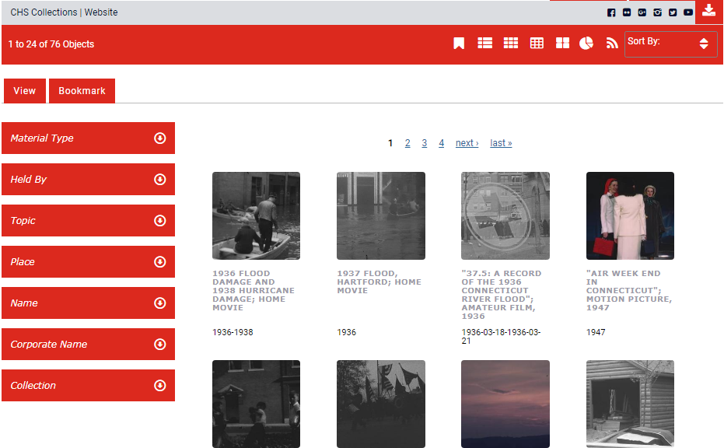
The solution(s)
Digital preservation and access

Slide 5
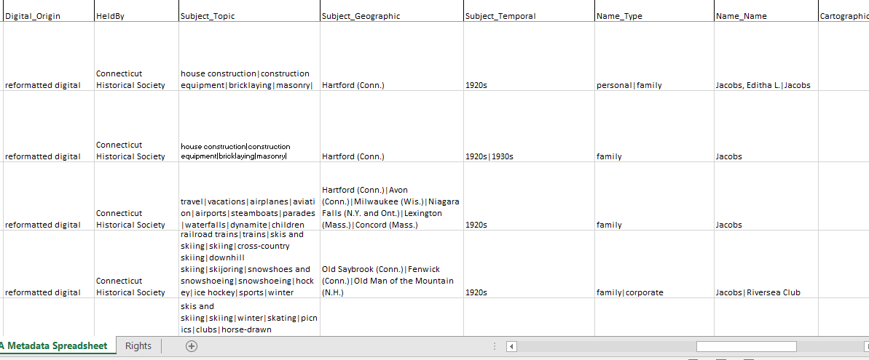
The process

