Slide 1
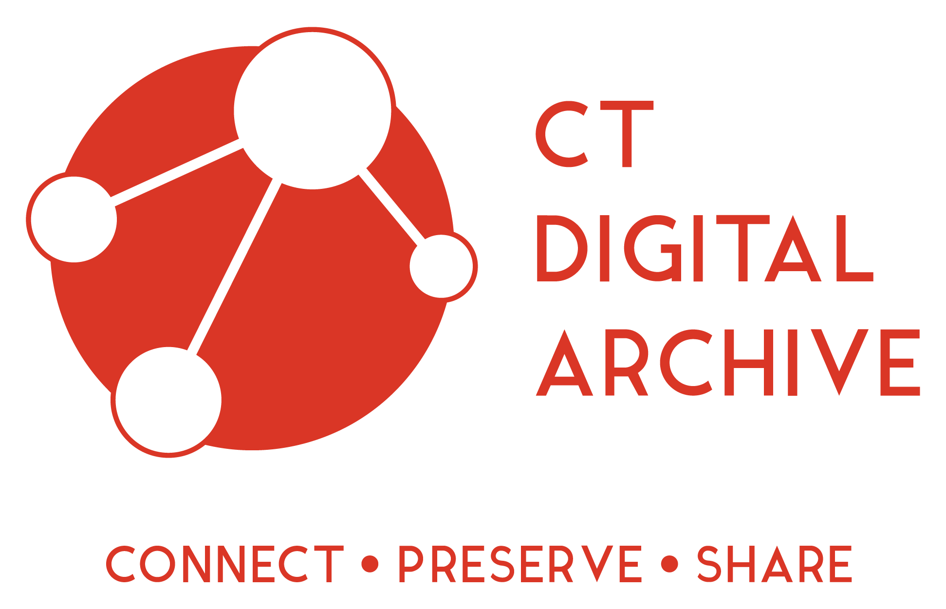
Introduction to the Connecticut Digital Archive

Slide 2
Connecticut Digital Archive homepage http://ctdigitalarchive.org/
Keyword searching across all collections and digital objects
Browsing the collection by institution and thereunder by collection
Searching within collections

Slide 3
Overview
How to become a member
Getting started in the repository

Slide 4
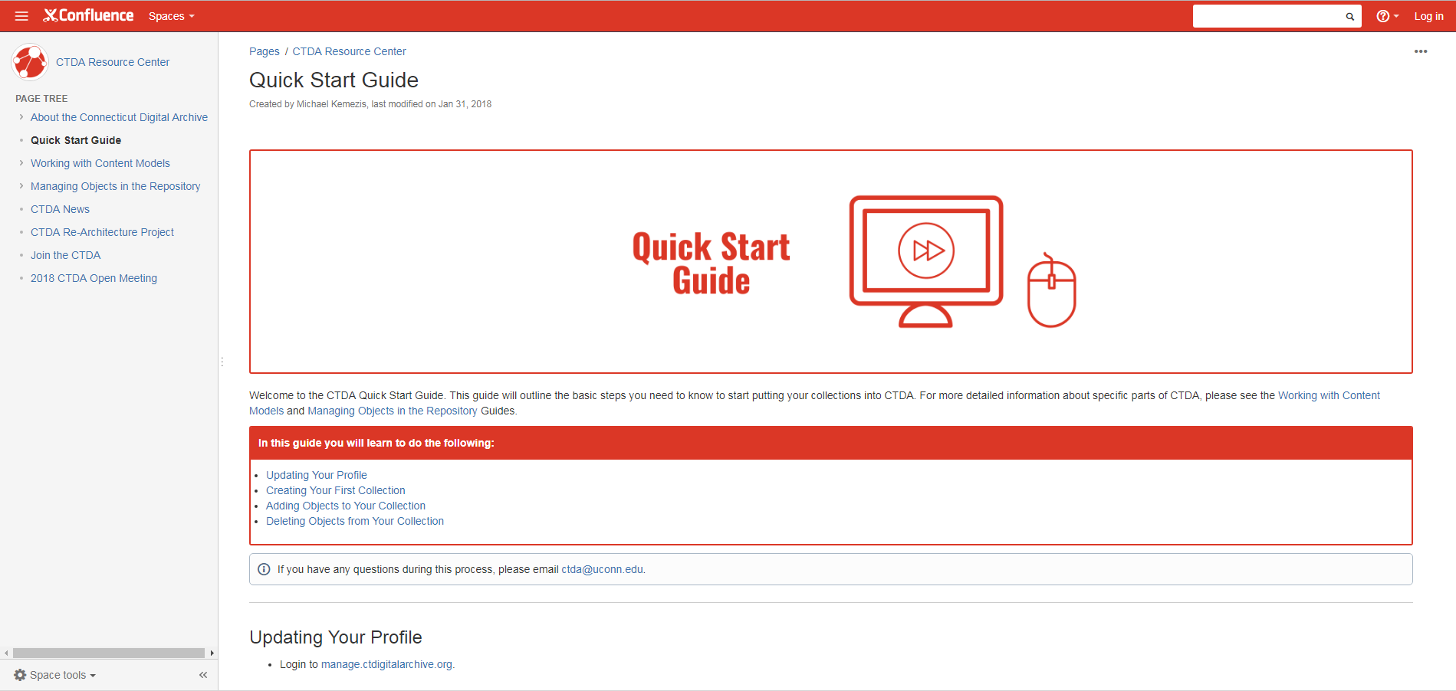
Resource Center
Notes:
You can email us as well.

Slide 5
CTDA Vocabulary
Community Member
Collection
Digital Object
MODS Form
Ingest
Content Model
Datastreams
Namespace, PID, Handle
https://confluence.uits.uconn.edu/confluence/display/CTDA/CTDA+Glossary

Slide 6
Community Member
Cultural heritage institutions across the state of Connecticut

Slide 7
Collection

Slide 8
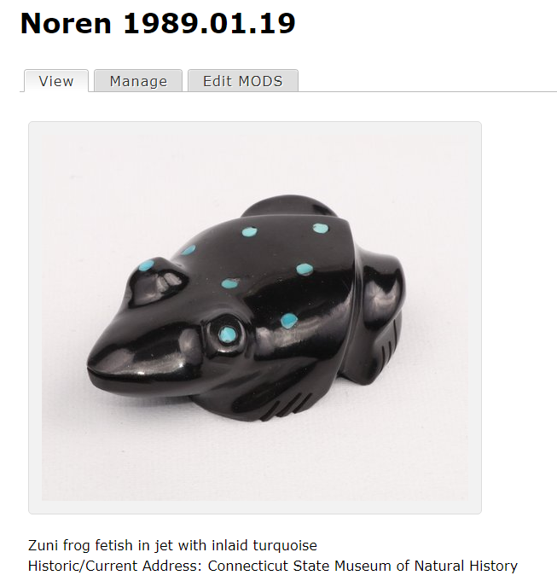
Digital Object

Slide 9
MODS form

Slide 10
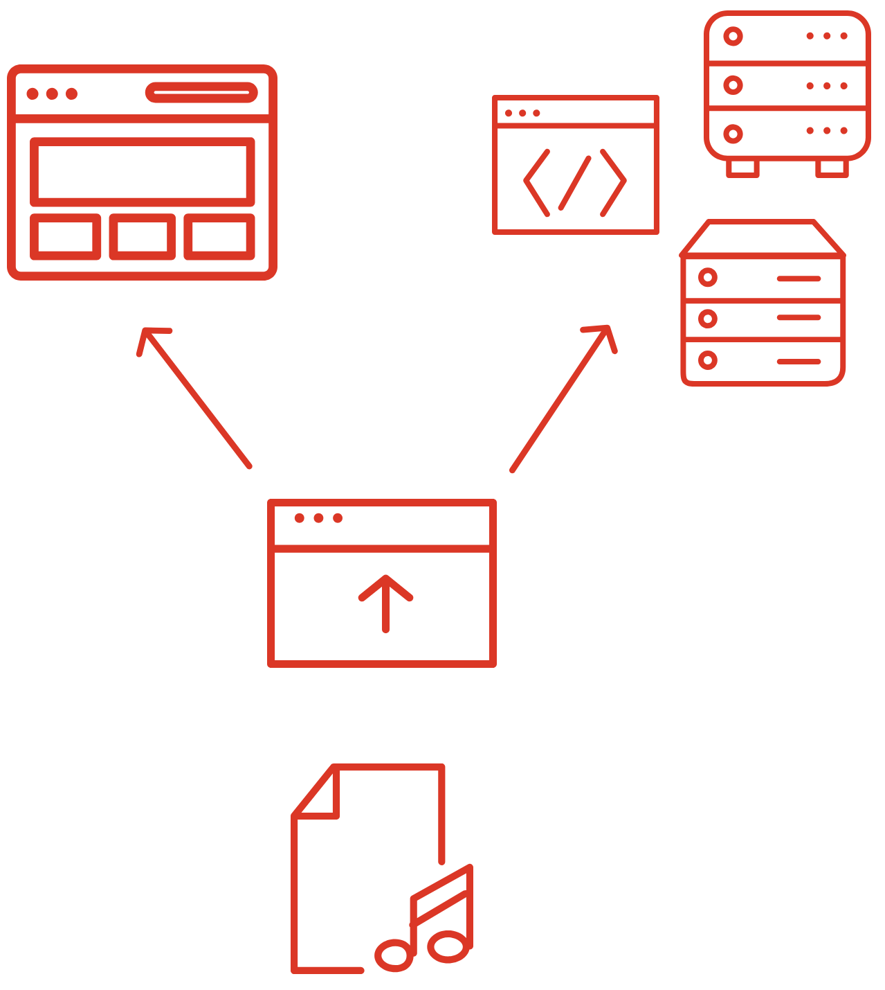
Ingest
https://confluence.uits.uconn.edu/confluence/display/CTDA/Quick+Start+Guide
Notes:
Adjust visual

Slide 11
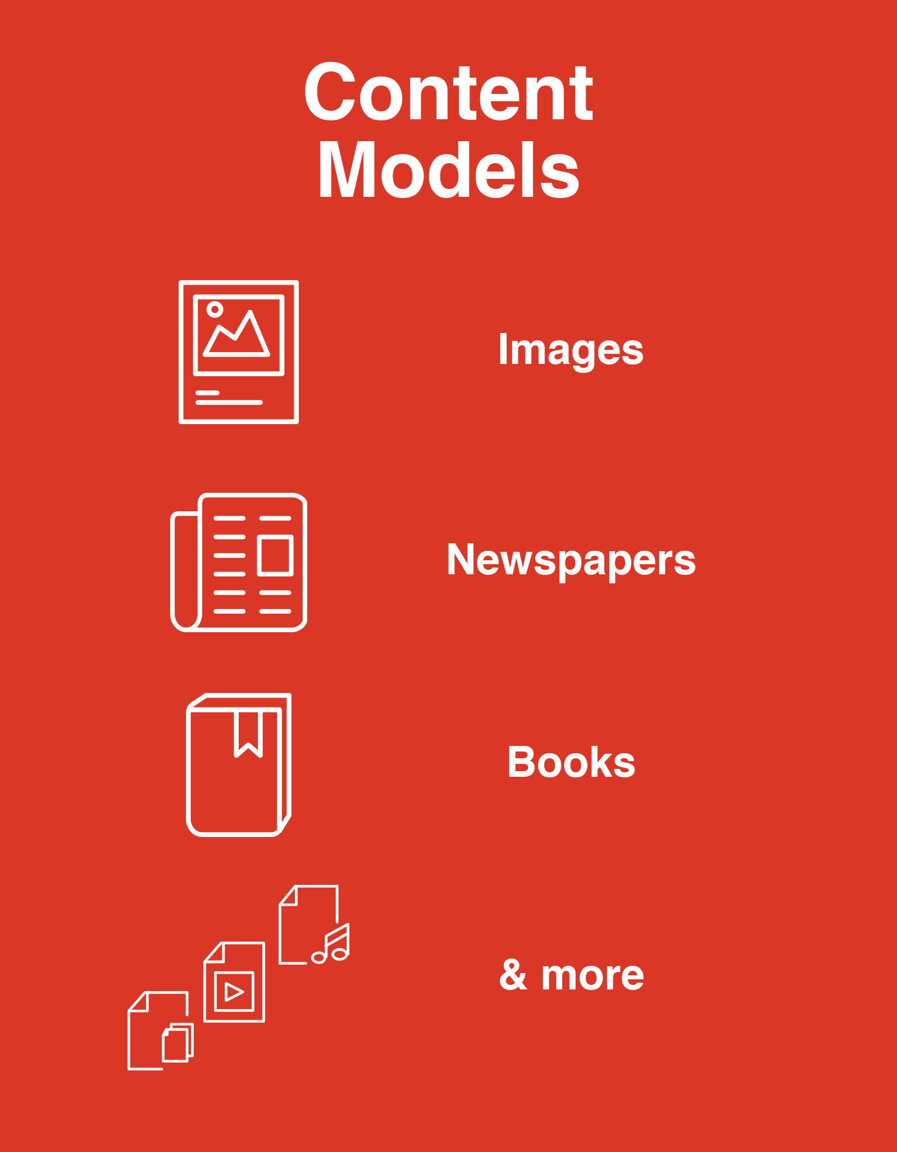
Content Model​ | File Format​
Audio​ | WAV, mp3​
Basic Image​ | gif, png, jpg, jpeg​
Binary​ | Any file format​
Book​ | tiff, jp2​
Large Image​ | tiff, tif, jp2​
Manuscript​ | tiff, jp2​
PDF​ | pdf​
Video​ | mp4​
https://confluence.uits.uconn.edu/confluence/display/CTDA/Working+with+Content+Models

Slide 12
Datastreams

Slide 13
Namespace, PID, Handle, URL
Namespace 210002
PID 210002:14
Handle http://hdl.handle.net/11134/210002:14
URL in CTDA
http://collections.ctdigitalarchive.org/islandora/object/210002%3A14

Slide 14
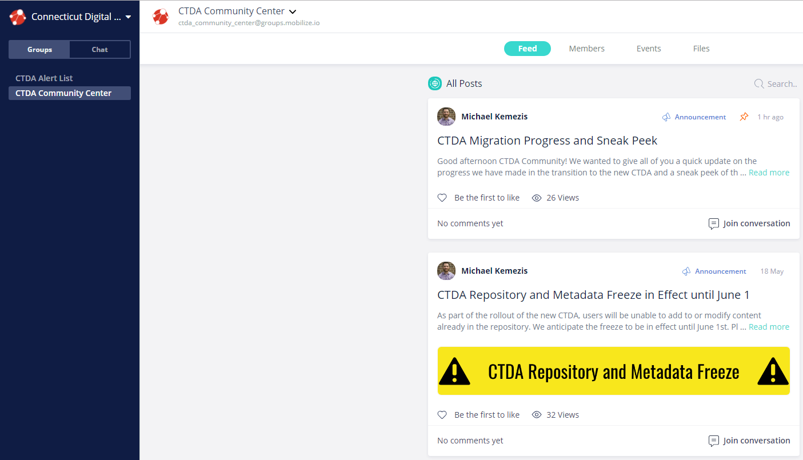
Community Center & Alert List
Notes:
What's the email for help?

Slide 15
Things to consider when you start ingesting:
Content Model | File Format
Audio | WAV, mp3
Basic Image | gif, png, jpg, jpeg
Binary | Any file format
Book | tiff, jp2
Large Image | tiff, tif, jp2
Manuscript | tiff, jp2
PDF | pdf
Video | mp4
Titles and other descriptive information

Slide 16
Description basics
Required fields
Linked data/thesauri
Dates: YYYY-MM-DD

Slide 17
Demonstration
http://ctda-staging1.lib.uconn.edu/
Notes:
Manage tab

Slide 18
Some additional points to keep in mind:
None of the work you do on the Stage site can transfer over to the Presentation site, so there is no need to spend too much time working on any particular record in the sandbox.
YOU are in charge of your collections and digital objects. The CTDA does not tell any Community Member what to put online, how to describe it, or even if the items should be accessible by the public.

Slide 19
When you decide to become a Community Member:
Signed Memorandum of Understanding
logo, slogan and other preferences
logins for Presentation side
CTDA Community Center, Resource Center
Participant, Alert and Newsletter email lists

