Slide 1
Highlights from the Avon Library's CTDA projects
Presented by Tina Panik
Avon Free Public Library

Slide 2
Avon Library: who we are
Avon Library: what we have
Suburban public library
History Room is part of Reference
Population: 18,000 Building Size: 42,000 sq. ft.
Annual Budget: $1.5 million Full-Time Equivalent: 14.5 Hours Open per Week: 52
Annual Circulation: ~285,000
Average Daily Visits: ~500
Programs per year: ~1200
168 books from the original Northington Library collection, 1700-1800’s
182 maps covering 1625-early 2000’s. The maps were created between 1829-2000
124 original land deeds, 1766-1903
54 bound probate volumes
26 bound volumes of Avon News (just digitized!)
717 ephemera files….and growing!
272 boxes in the archives

Slide 3
The recipe for our CTDA projects
1. Internal prep
2. CTDA workflow
3. Community Showcase
Read and research
Secure permissions
Create a work plan
Scan each page individually as a TIFF file, labeling by date and page number
Upload to CTDA using the appropriate content model
WWII newsletters:
manuscript content model
Hadsell Brothers:
large image content model
Lure of Litchfield Hills:
book content model
Feature collections with a
program
gallery show
series of promotions

Slide 4
Highlight #1: WWII Newsletters
14 resident-created newsletters spanning the years 1943-1946.
Intended for Avon soldiers, sent wherever they were stationed, as well as to their families in Avon.
included local town gossip and news
Notes:
Manuscript Content Model
Add a TEI datastream that contains Katie’s notes and highlights
Enter Katie’s notes into the description field so they become “searchable” terms

Slide 5
Why the manuscript model? Why TEI?
From this:
individual TIFF files and pages
To this:
complete newsletter displayed with notes
using
TEI

Slide 6
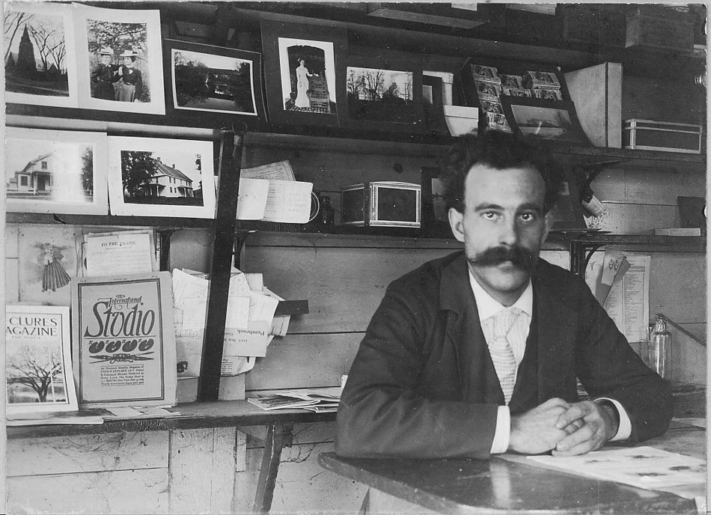
Highlight #2: The Hadsell Brothers
269 glass negatives and photographic prints by C.B. Hadsell taken from 1899-1919
135 glass negatives and photographic prints by Frank Hadsell from the same time period (with more to come!)
Diaries of Frank Hadsell from 1859-1942
Collection donated by descendants of the family

Slide 7
Why the photo model?
A collection of prints
Becomes accessible to all
Notes:
OCR performed
Index of articles created and entered in description

Slide 8
Highlight #3: Lure of the Litchfield Hills
Bi-annual magazine produced from 1940-1975 covering topics of interest within the Farmington Valley.
Ruth Vela, a descendant of Lewis S. Mills, gave us permission to digitize the issues
Farmington Valley libraries are contributing their holdings: Canton, Burlington

Slide 9
Why the book model?
An index of issues
A magazine reading experience
Notes:
OCR performed
Index of articles created and entered in description

Slide 10
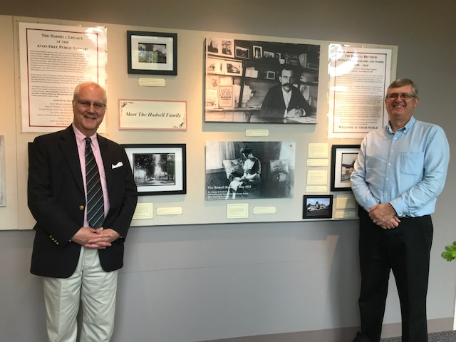
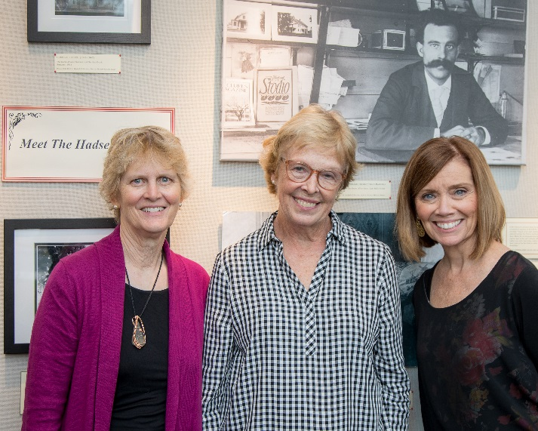
Community showcase: 2017 art gallery project

Slide 11
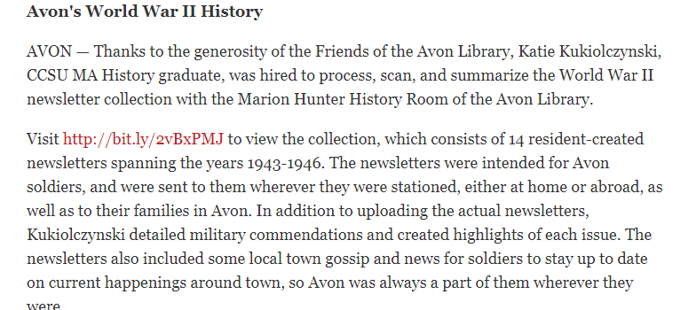
Community showcase: media coverage
March 20, 2018

Slide 12
Explore more of the Avon Library’s digital collections at: http://collections.ctdigitalarchive.org/
Tina Panik
Avon Library, Reference & Adult Services Manager
tpanik@avonctlibrary.info

