Slide 1
Breaking free of the finding aid
CTDA Open Meeting
15 June 2018

Slide 2
Notes:
Many presentations over the years
Standard information
Valuable contextualization
Audience
Discovery

Slide 3
Notes:
Advances in technology
Presentation options
Less reliance on contextualization more on presentation
Audience
Discovery

Slide 4
Notes:
Particularly works well with images

Slide 7
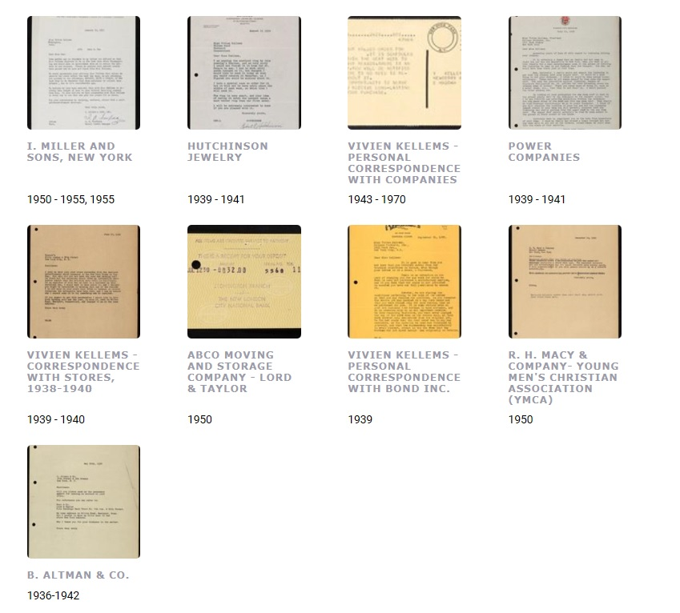
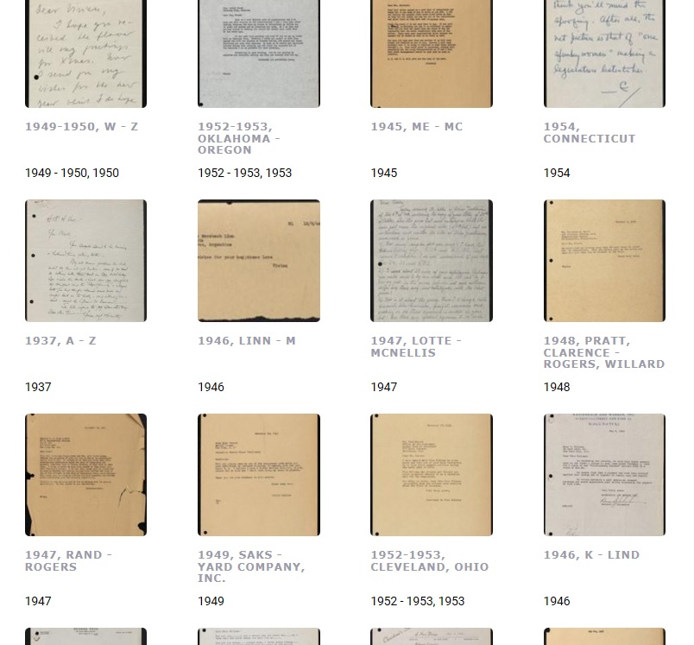

Slide 8
Questions?
Betsy Pittman
Betsy.Pittman@uconn.edu
860.486.4507

